Slide 1

AMRITA SCHOOL OF ARTIFICIAL INTELLIGENCE, BENGALURU
B. Tech in Artificial Intelligence and Data Science (AID)
Fourth Semester, Section F, Academic Year: 2023-24
OPERATING SYSTEMS (23AID213)
END-TERM PROJECT PRESENTATION
on
OPTIMIZING URBAN TRAFFIC USING OS-BASED SYNCHRONIZATION AND RESOURCE ALLOCATION
Presented by Group No. 13
K Nikhilesh (BL.EN.U4AID23023)
M Thanuj Kumar (BL.EN.U4AID23030)
M Jayavardhan (BL.EN.U4AID23033)

Slide 2
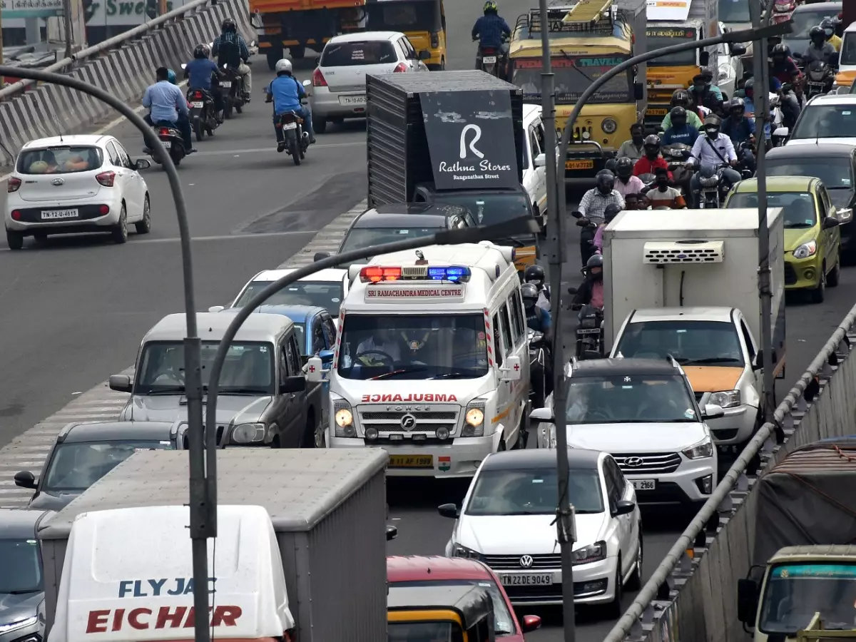
Motivation
Urban traffic congestion delays ambulances, risking lives.
Fixed traffic signals cause inefficiencies and pollution.
Emergency delays reduce survival rates in critical situations.
Despite being a tech-driven city, Bangalore still relies on outdated, non-responsive traffic systems.

Slide 3
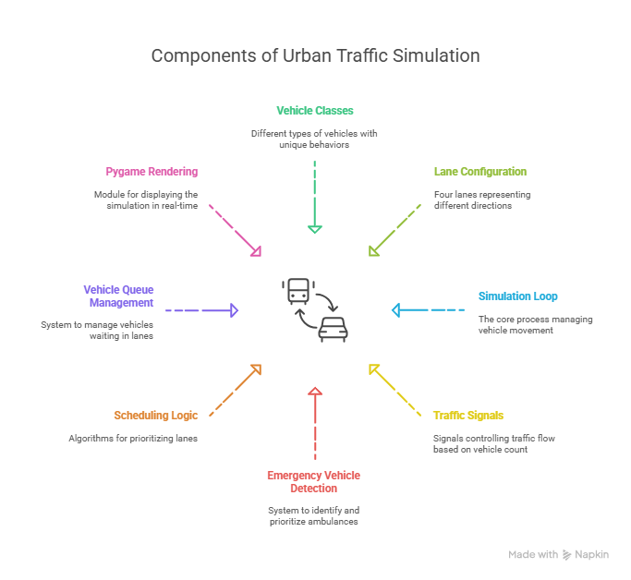
Motivation : Our Approach
Prioritizes ambulances with FCFS scheduling.
Adjusts signals dynamically based on vehicle density.
Simulates smart traffic management using Python and Pygame.
Ambulance prioritization using FCFS scheduling is especially beneficial during peak hours on routes like Outer Ring Road and Bannerghatta Road, where delays are frequent and critical.

Slide 4
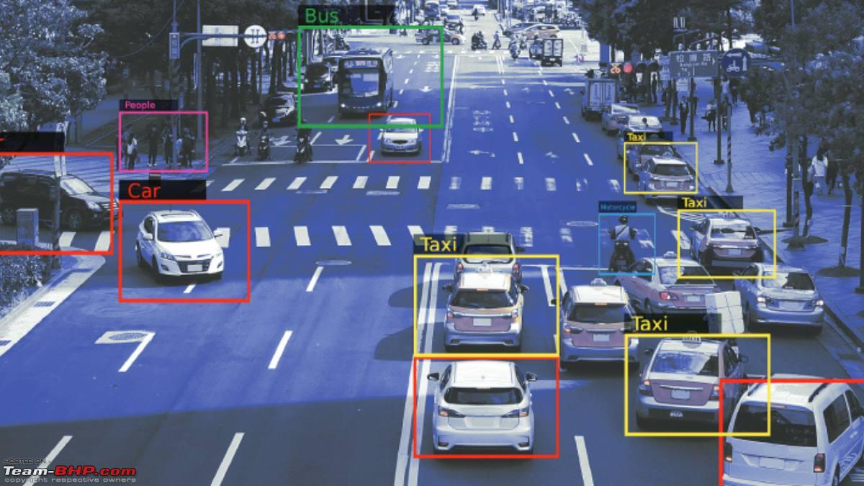
Motivation : Why its important?
Saves lives by speeding up emergency responses.
Reduces congestion, fuel use, and emissions.
Supports smart cities for safer, greener roads.
Reduces travel time variability, increasing the efficiency of emergency services and public transport systems.

Slide 5
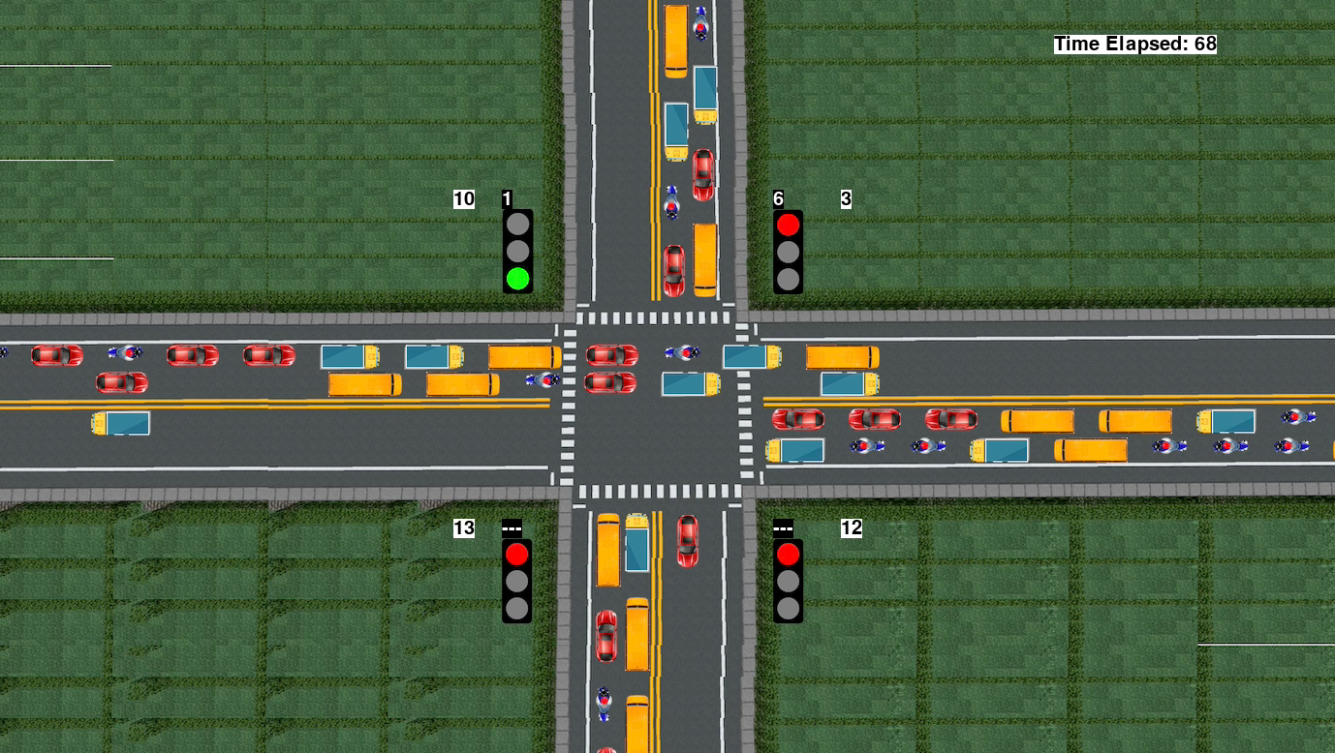
Introduction : Smart Traffic Signal Simulation
Simulates a smart traffic signal system using Python and Pygame.
Features:
Prioritizes ambulances with FCFS scheduling.
Dynamically adjusts signals based on vehicle density.
Realistic vehicle movement with lane and turn logic.
Goal: Optimize traffic flow and enhance emergency response.

Slide 6
Literature Survey

Slide 7
Year | Study Name | OS Topics | Methodology | Results / Key Takeaways | What They Did Not Do | What We Did
2023 | Optimized Resource Allocation and Queue Management for Traffic Control in MANET | Queue management, resource allocation | Fuzzy logic to prioritize vehicle flow in MANETs | Improved QoS metrics | Not designed for fixed intersections; lacks signal scheduling or thread-level concurrency | Designed for 4-way intersections, uses signal scheduling and dynamic vehicle-based green timing
2014 | Resource Allocation Strategies for Traffic Signals | Resource planning and maintenance | Simulation-based resource use optimization | Strategic operation improvement | No real-time control or preemption handling | Our system dynamically adjusts timing and handles emergency preemption (ambulances)
2009 | Traffic Management in Small Networks | Rate limiting, OS-level traffic interfaces | Host-based rate control for fairness | Stable bandwidth sharing | Not intended for signal or intersection management | Focused on intersection resource sharing with direction-wise logic and synchronization
2020 | Optimization for Connected Autonomous Driving | Scheduling, resource optimization | Combines ADMM and bandit learning | Boosts road stability | No signal logic or light-level scheduling | Our system schedules green lights using traffic density and integrates direction-based thread simulation

Slide 8
Year | Study Name | OS Topics | Methodology | Results / Key Takeaways | What They Did Not Do | What We Did
2019 | Resource Allocation in Vehicular Edge Computing | Task scheduling | Bat algorithm for offloading | Efficient computation | Focuses on cloud offloading, no traffic light control | Models traffic lights as schedulers using vehicle types and queue lengths
2023 | SDN Resource Pre-Allocation for ITS | Resource pre-allocation via SDN | Neural time-series for predicting traffic load | Accurate pre-allocation | Does not use OS-level synchronization or vehicle classification | Uses per-vehicle-type timing logic (ambulances, bikes, trucks), with preemptive signal flow
2025 | Dynamic OS Scheduling Using Double DQN | Task scheduling | Double Q-learning for system tasks | Better task throughput | Not traffic-specific; focuses on abstract task loads | Applies thread-based scheduling directly to vehicle flow and signals
2022 | Synchronous Resource Allocation Modeling | Server sync, capacity optimization | Queuing networks + LP optimization | Optimized assignment logic | No dynamic real-time integration | Used dynamic queue-based traffic signal switching via thread-safe scheduling

Slide 9
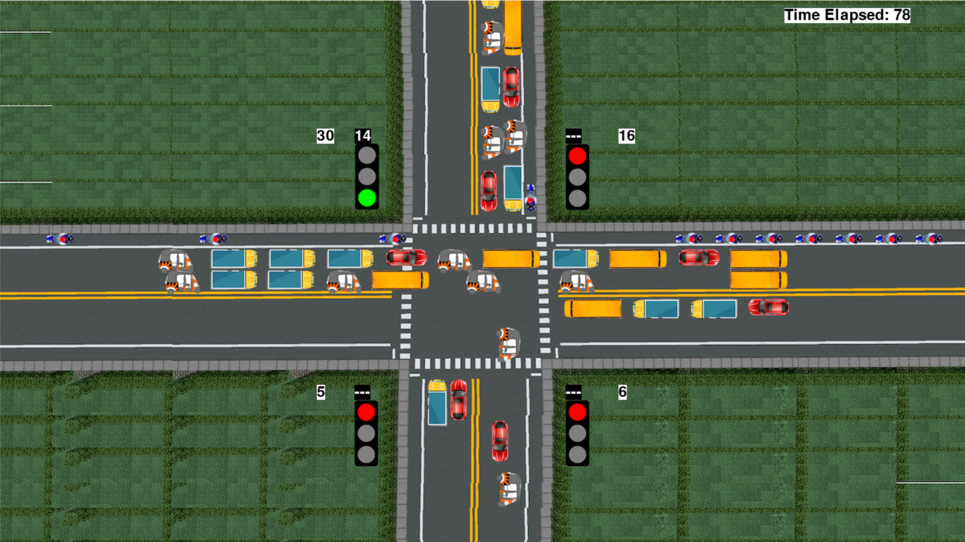
Problem Statement
Urban traffic congestion delays emergency vehicles, risking lives.
Fixed-time traffic signals are inefficient, ignoring real-time traffic.
No prioritization for ambulances, causing critical delays.
The system currently fails to prioritize emergency vehicles; even when ambulances are present in a lane, the signal does not turn green, leading to unnecessary delays."

Slide 10
OS-Based Solution
Priority Scheduling & FCFS: Ambulances get green first; FCFS prioritizes first detected in multiple lanes.
Maximum Vehicles First: Green given to lane with most vehicles, unlike SRTF, which favors fewer vehicles, worsening busy lanes.
Why Not SRTF: SRTF prioritizes shortest crossing time, clearing fewer vehicles first, leading to congestion in high-traffic lanes.
Round Robin Clarification: No fixed 20-second green; dynamic timing (10-60 seconds) based on vehicle density.

Slide 11
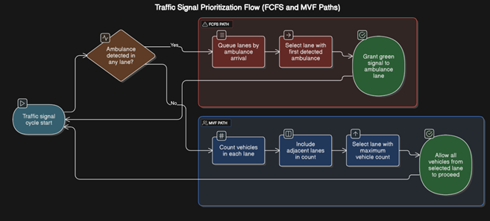
OS-Based Solution

Slide 12
Project Objective
CO Alignment:
CO1: Simulated OS scheduling, file I/O (code: simulationTime()).
CO2: FCFS for ambulances, MVF for others (code: checkAmbulances(), repeat()).
CO3: Synchronized signals (code: currentGreen).
CO4: Analyzed memory usage (code: vehicles dictionary, file write).

Slide 13
Methodology : System Architecture
System Overview: Python-Pygame simulation of a four-way intersection.
Components: Signals (4 directions), vehicles (cars, ambulances, etc.), scheduler.
Flowchart Overview:
Detects ambulances, applies FCFS for priority (first ambulance lane gets green).
Uses Maximum Vehicles First for other lanes (SRTF avoided due to congestion).
Dynamic green timing (10-60 seconds, not Round Robin’s fixed 20 seconds).
Operation: Vehicles move, signals update, output saved (counts, throughput).

Slide 14
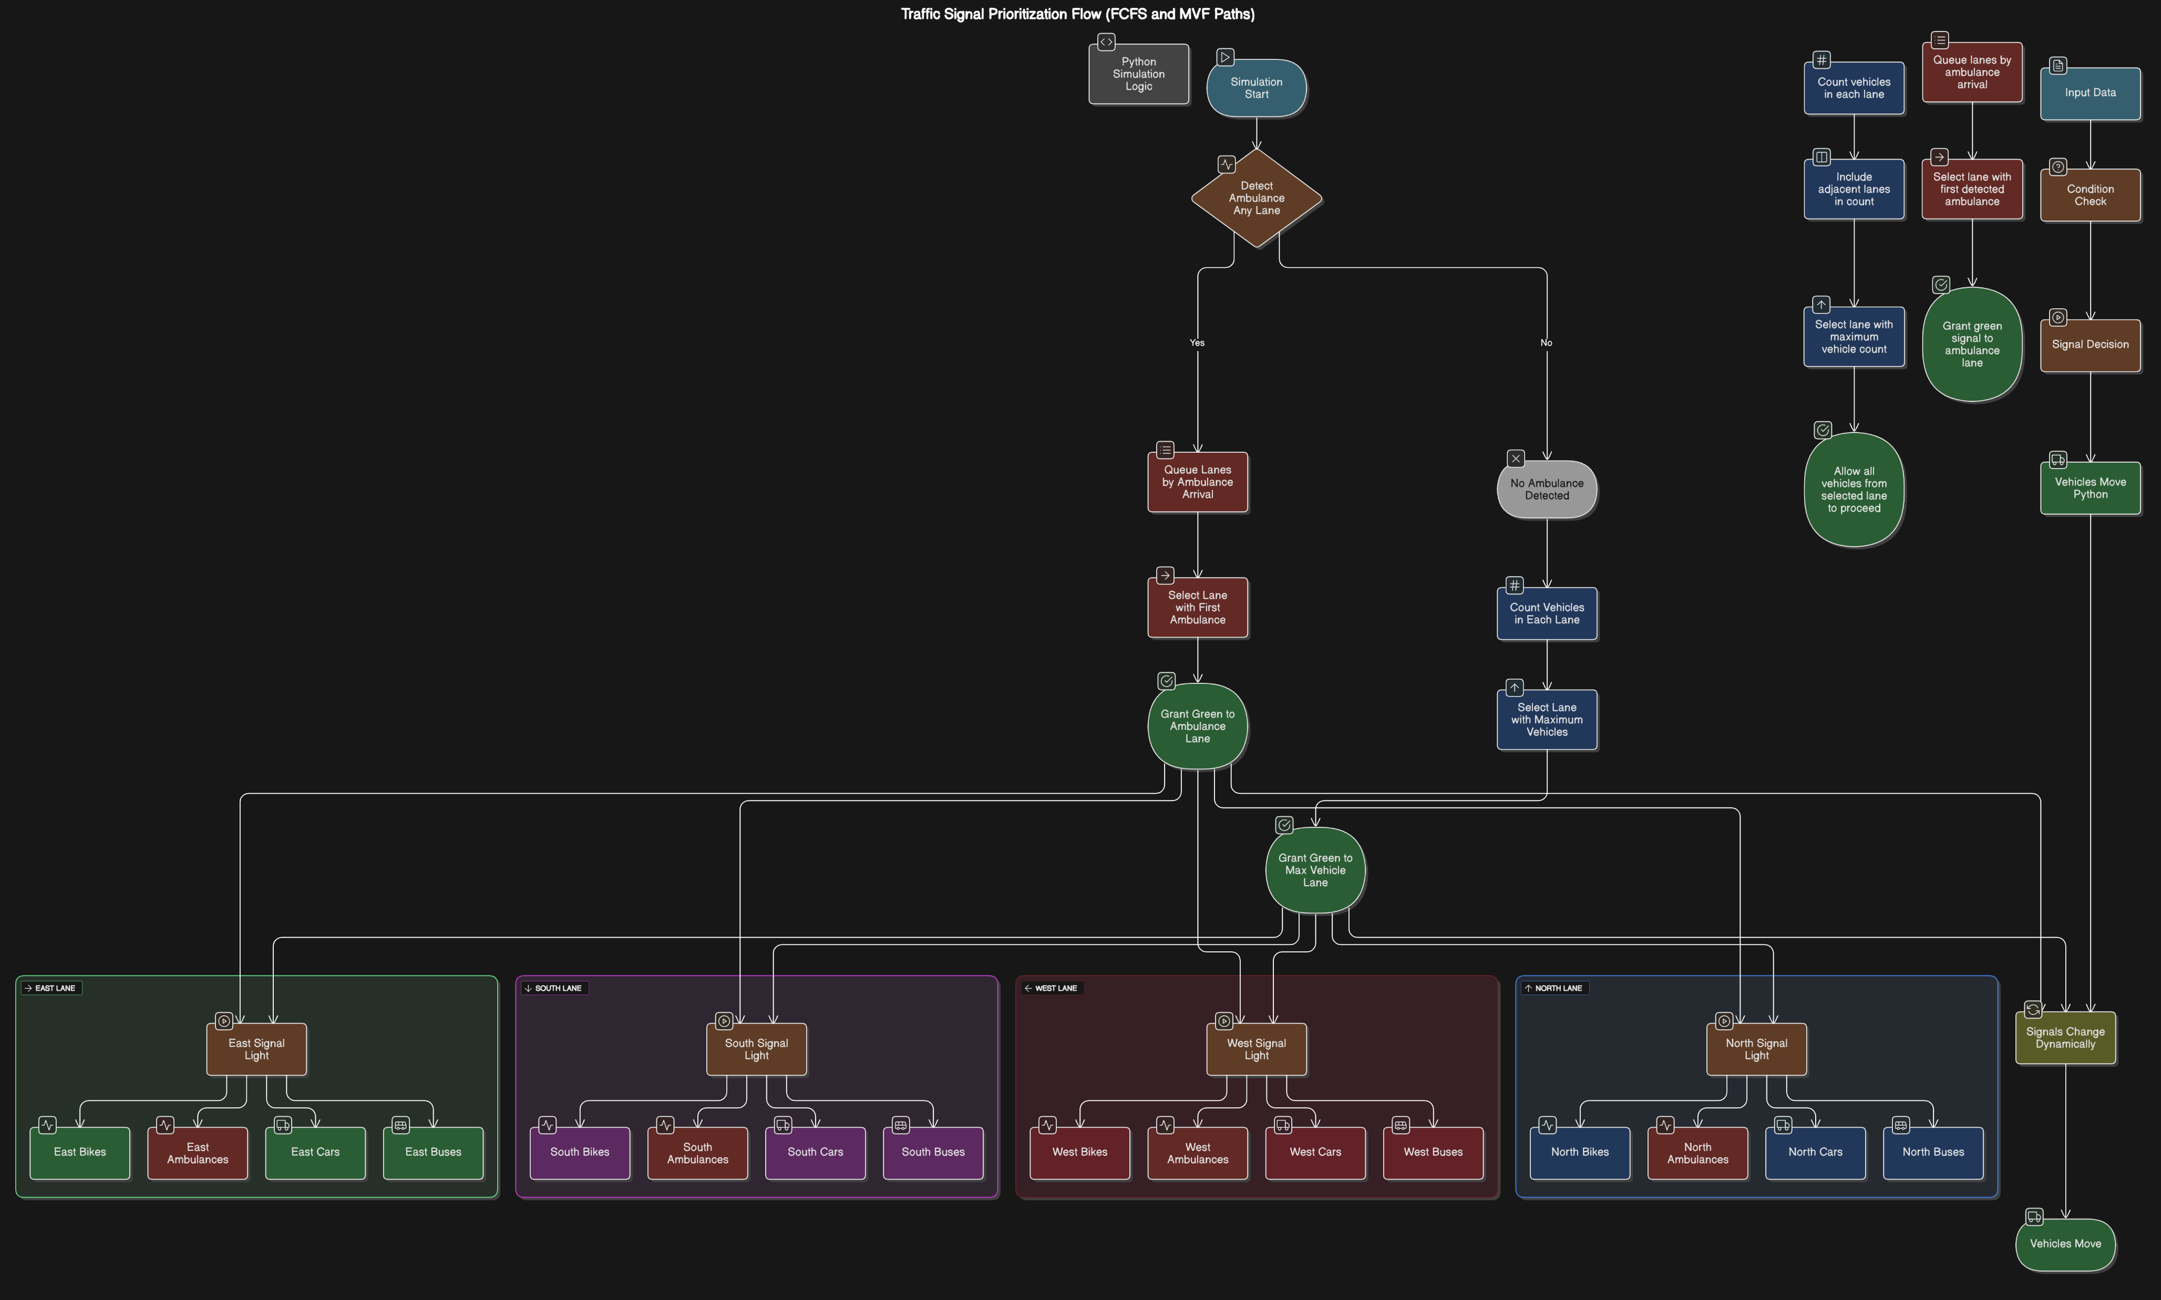
Methodology

Slide 15
Results and Demo
Before (Fixed-Time Signals, No Ambulance Priority):
Simulation: 300 seconds, fixed 20-second green per lane.
Total Vehicles Passed: 120 vehicles (East: 30, South: 28, West: 32, North: 30).
Throughput: 0.40 vehicles/second (120 ÷ 300).
Efficiency: Ambulances delayed (2-3 seconds crossing), uneven lane clearing.

Slide 16
Results and Demo
After (FCFS for Ambulances, MVF for Others):
Simulation: 300 seconds, dynamic green (10-60 seconds).
Total Vehicles Passed: 165 vehicles (East: 45, South: 38, West: 42, North: 40).
Throughput: 0.55 vehicles/second (165 ÷ 300).
Efficiency: Ambulances crossed faster (1.5 seconds), busy lanes cleared better.

Slide 17
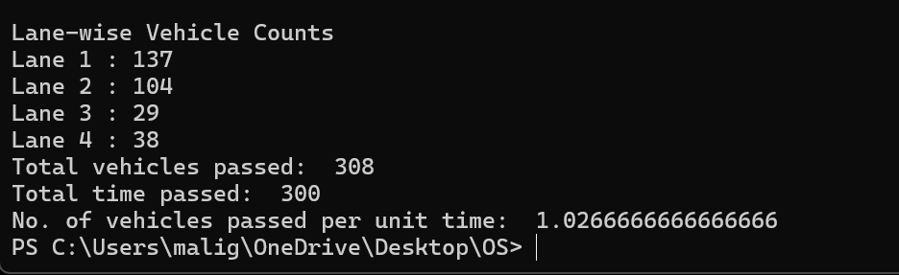
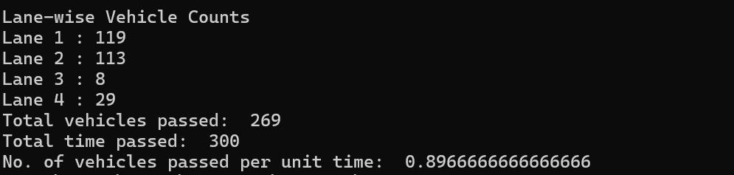
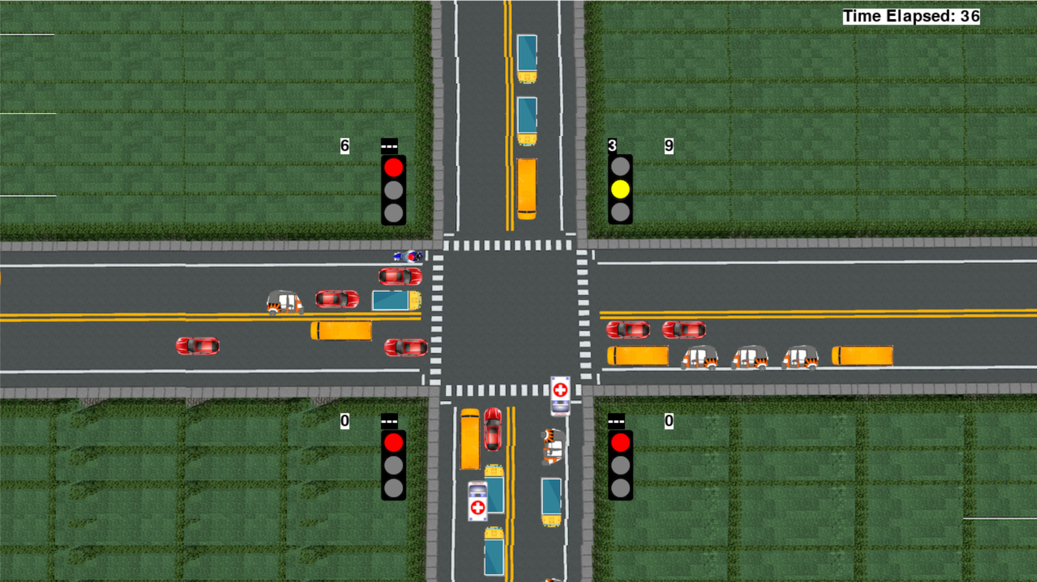
Results and Demo

Slide 18
Conclusion
Bengaluru’s Challenge: Fixed signals delay ambulances, low throughput (like "before" output: 0.40 vehicles/second).
Our Solution: Created a smart traffic system in Pygame using FCFS for ambulances, MVF for others (flowchart image).
Impact:
Throughput increased to 0.55 vehicles/second ("after" output), a 37.5% improvement.
Ambulances prioritized (FCFS), reducing delays (code: checkAmbulances()).
Dynamic green times (MVF) clear busy lanes faster (code: repeat()).

Slide 19
Future Works
CO1 : Enhancement: Use real system calls (e.g., fork() for vehicles, beyond code’s simulation).
CO2 : Improvement: Add preemptive scheduling (code: enhance checkAmbulances() for other emergencies).
CO3 : Advancement: Add semaphores (code: improve currentGreen synchronization).
CO4 : Expansion: Optimize memory (code: reduce vehicles dictionary size, file buffer).
Additional Features:
Real-time traffic data (extend code’s generateVehicles() with IoT data).

Slide 20
Thank You

